Slide 1

Intro to Transcriptomics Programming for Biologists CSHL 2017
Brian Haas
Broad Institute

Slide 2
Transcriptomics Lecture Overview
Overview of RNA-Seq
Transcript reconstruction methods
Expression quantitation
Differential expression analysis

Slide 3
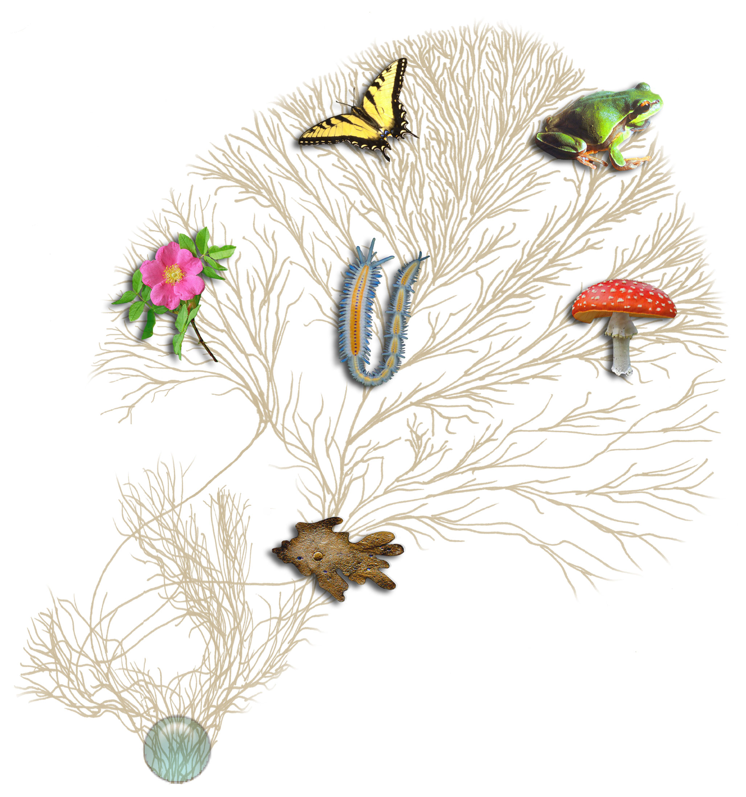
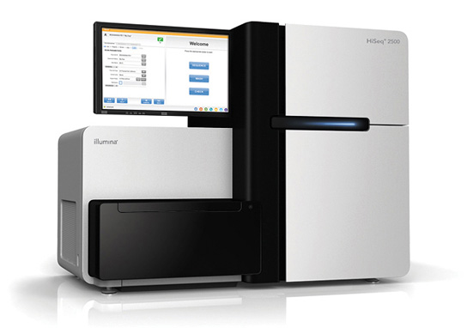
RNA-Seq Empowers Transcriptome Studies
Extract RNA, convert to cDNA
Next-gen Sequencer
(pick your favorite)
Notes:
RNA-Seq is a powerful technology for identifying genes and profiling gene expression in any living organism.
----
It just requires that you can collect RNA molecules from your sample of interest, convert it to cDNA,
---
and then perform high throughput sequencing using your favorite next-generation sequencing technology.
# image from: http://tolweb.org/tree/home.pages/aboutoverview.html#imguse

Slide 4
RNA-Seq Empowers Many Facets of Biological Investigations
Transcript identification (ie. which genes active)
Expression Levels
Alternative splicing isoforms
Allelic variants
Mutations
Fusion Transcripts
RNA-editing

Slide 5
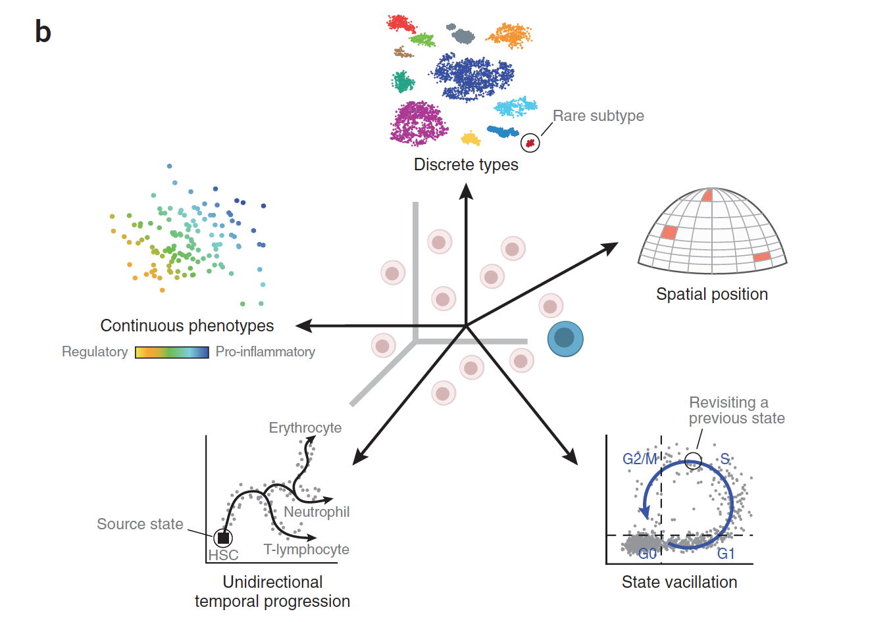
RNA-Seq is Empowering Discovery at Single Cell Resolution
Wagner, Regev, and Yosef. NBT 2016

Slide 6
RNA-Seq: How do we make cDNA?
Prime with Random Hexamers (R6)
mRNA
5’
3’
R₆
R₆
R₆
Reverse transcriptase
cDNA First strand synthesis
R₆
R₆
R₆
RNase H
DNA polymerase
DNA Ligase
cDNA Second strand synthesis
Illumina cDNA Library
Slide courtesy of Joshua Levin, Broad Institute.

Slide 7
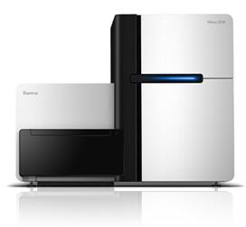
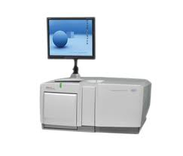
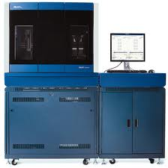
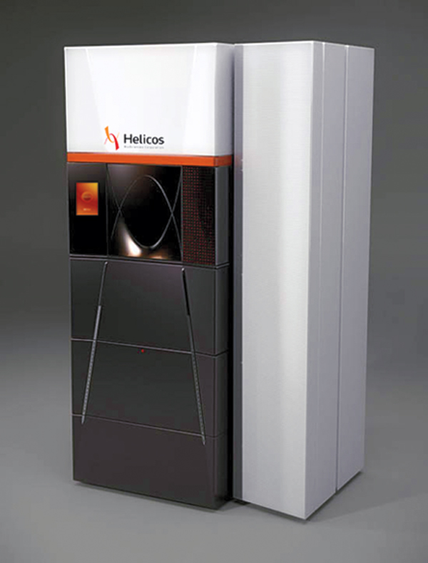
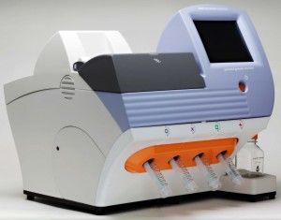
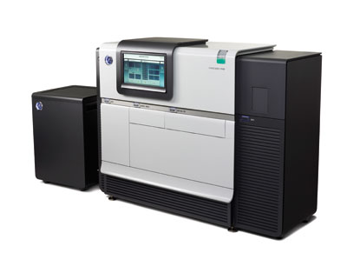
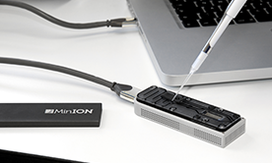
Generating RNA-Seq: How to Choose?
Many different instruments hit the scene in the last decade
Illumina
454
SOLiD
Helicos
Ion Torrent
Pacific Biosciences
Oxford Nanopore
Slide courtesy of Joshua Levin, Broad Institute.

Slide 8
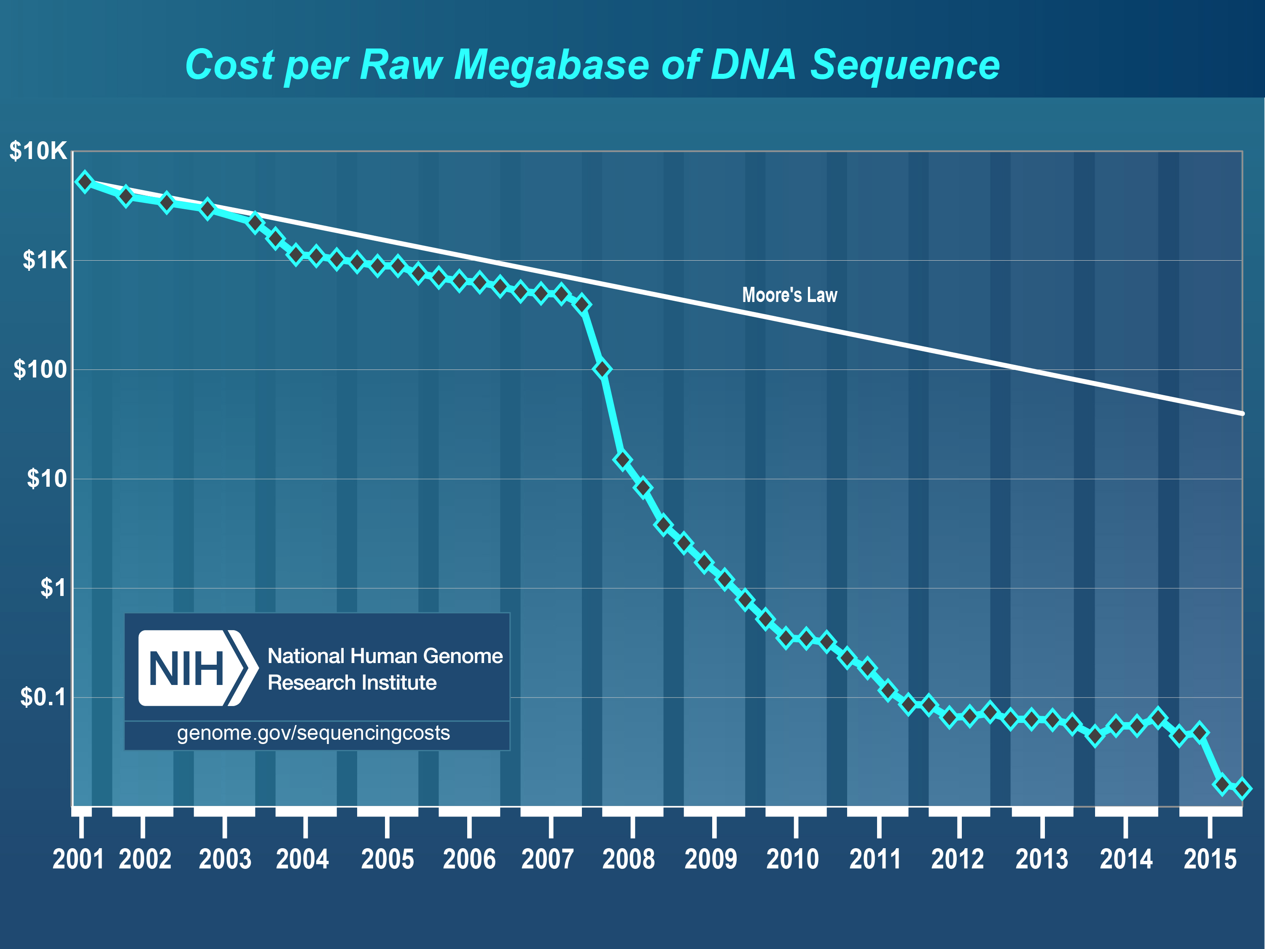
Hello Next-Gen Sequencing!
From https://www.genome.gov/sequencingcostsdata/

Slide 9
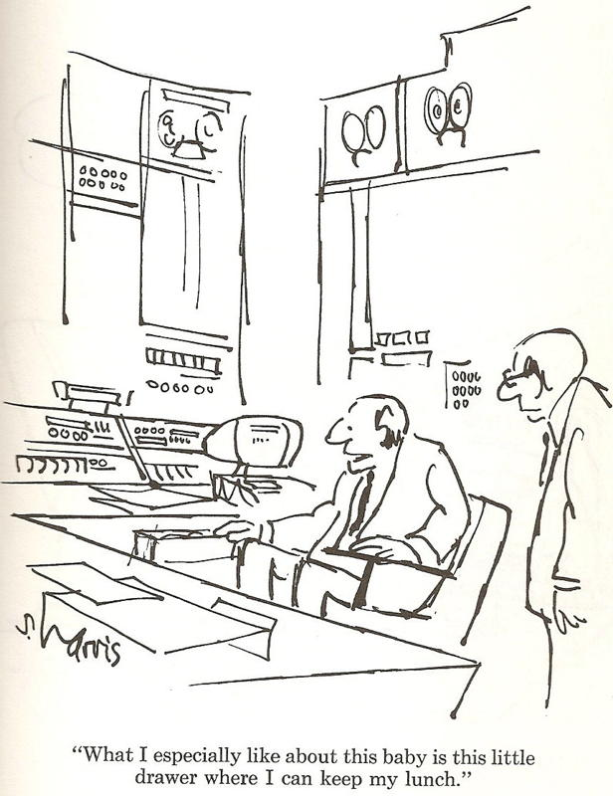
RNA-Seq: How to Choose?
Illumina
454
SOLiD
Helicos
Ion Torrent
Pacific Biosciences
Oxford Nanopore
Slide courtesy of Joshua Levin, Broad Institute.

Slide 10
Generating RNA-Seq: How to Choose?
Popular choices for RNA-Seq today
Illumina
454
SOLiD
Helicos
Ion Torrent
Pacific Biosciences
Oxford Nanopore

Slide 11
Generating RNA-Seq: How to Choose?
Popular choices for RNA-Seq today
[Current RNA-Seq workhorse]
[Newly emerging technology for full-length single molecule sequencing]
Illumina
454
SOLiD
Helicos
[Full-length single molecule sequencing]
Ion Torrent
Pacific Biosciences
Oxford Nanopore

Slide 12
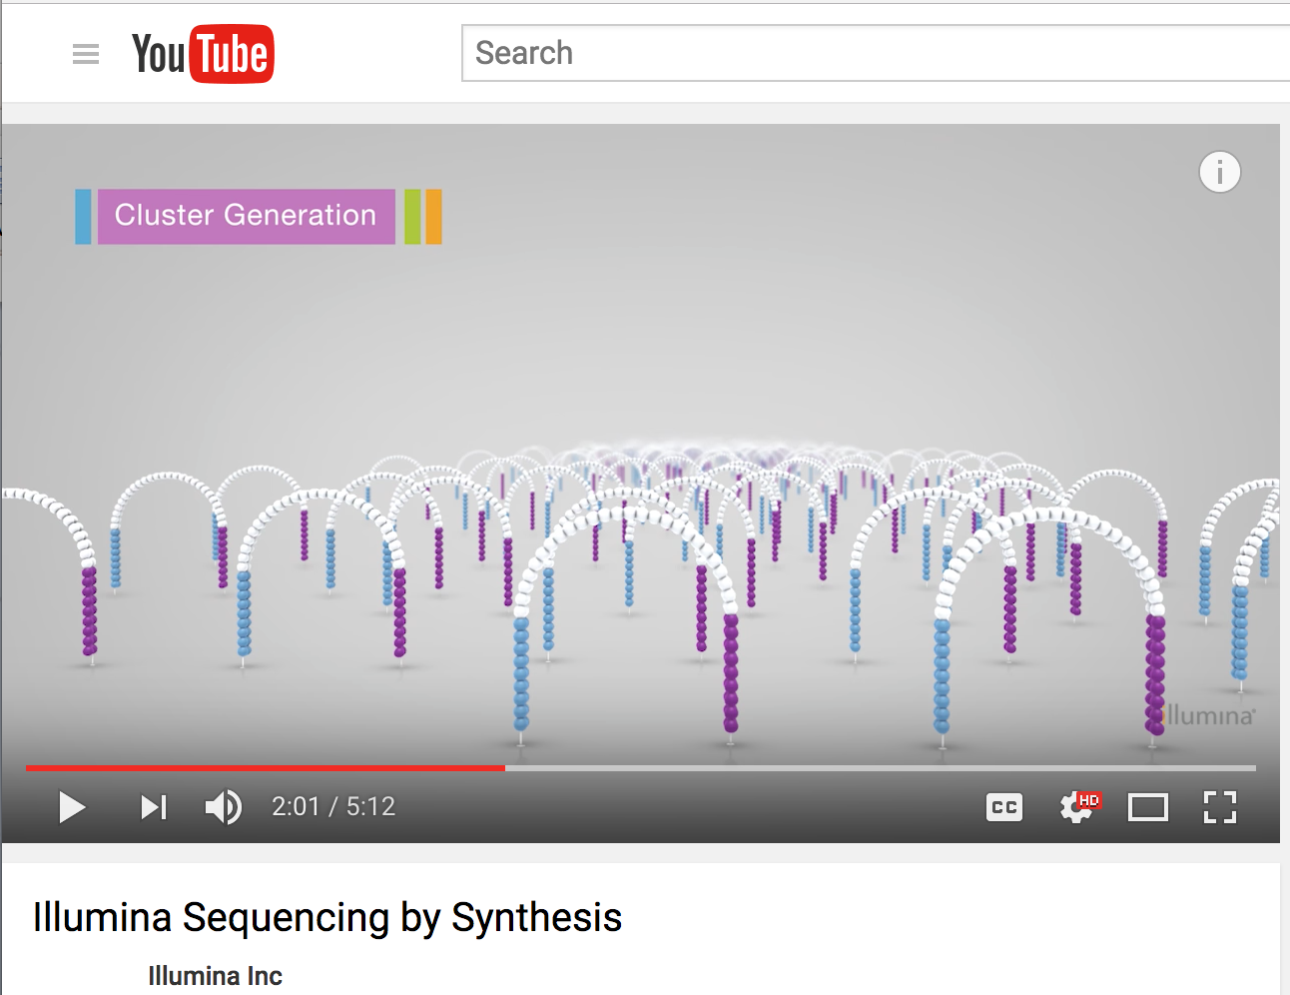
Illumina Sequencing by Synthesis
https://www.youtube.com/watch?v=fCd6B5HRaZ8

Slide 13
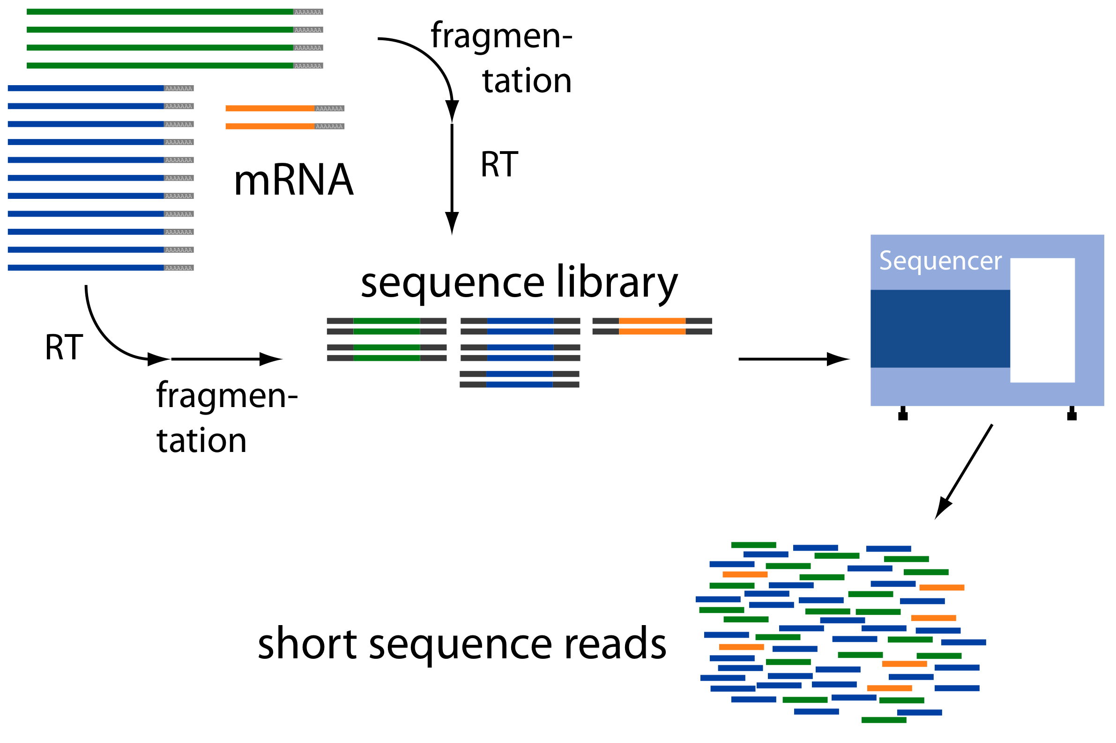
Overview of RNA-Seq
From: http://www2.fml.tuebingen.mpg.de/raetsch/members/research/transcriptomics.html

Slide 14
Common Data Formats for RNA-Seq
FASTA format:
>61DFRAAXX100204:1:100:10494:3070/1
AAACAACAGGGCACATTGTCACTCTTGTATTTGAAAAACACTTTCCGGCCAT
FASTQ format:
@61DFRAAXX100204:1:100:10494:3070/1
AAACAACAGGGCACATTGTCACTCTTGTATTTGAAAAACACTTTCCGGCCAT
+
ACCCCCCCCCCCCCCCCCCCCCCCCCCCCCBC?CCCCCCCCC@@CACCCCCA
Read
Quality values
AsciiEncodedQual(x) = -10 * log10(Pwrong(x)) + 33
AsciiEncodedQual (‘C’) = 64
So, Pwrong(‘C’) = 10^( (64-33/ (-10) ) = 10^-3.4 = 0.0004

Slide 15
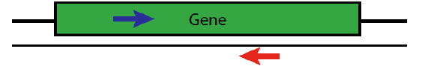
Paired-end Sequences
Two FastQ files, read name indicates left (/1) or right (/2) read of paired-end
@61DFRAAXX100204:1:100:10494:3070/1
AAACAACAGGGCACATTGTCACTCTTGTATTTGAAAAACACTTTCCGGCCAT
+
ACCCCCCCCCCCCCCCCCCCCCCCCCCCCCBC?CCCCCCCCC@@CACCCCCA
@61DFRAAXX100204:1:100:10494:3070/2
CTCAAATGGTTAATTCTCAGGCTGCAAATATTCGTTCAGGATGGAAGAACA
+
C<CCCCCCCACCCCCCCCCCCCCCCCCCCCCCCCCCCCCCCCCCCCCCBCCCC

Slide 16
RNA-Seq Challenge: Transcript Reconstruction
(Avg. ~ 2 kb)
(Avg. ~ 300 b)
Reconstruct original full-length transcripts
(~ 75 to 150 b reads, SE or PE)
Adapted from: http://www2.fml.tuebingen.mpg.de/raetsch/members/research/transcriptomics.html
Notes:
In any case, the transcriptome reads that are generated from sequencing are often much shorter than the original transcript molecules they were derived from, and one of the key bioinformatic challenges is to reconstruct the original full length transcript from the shorter sequencing reads.

Slide 17
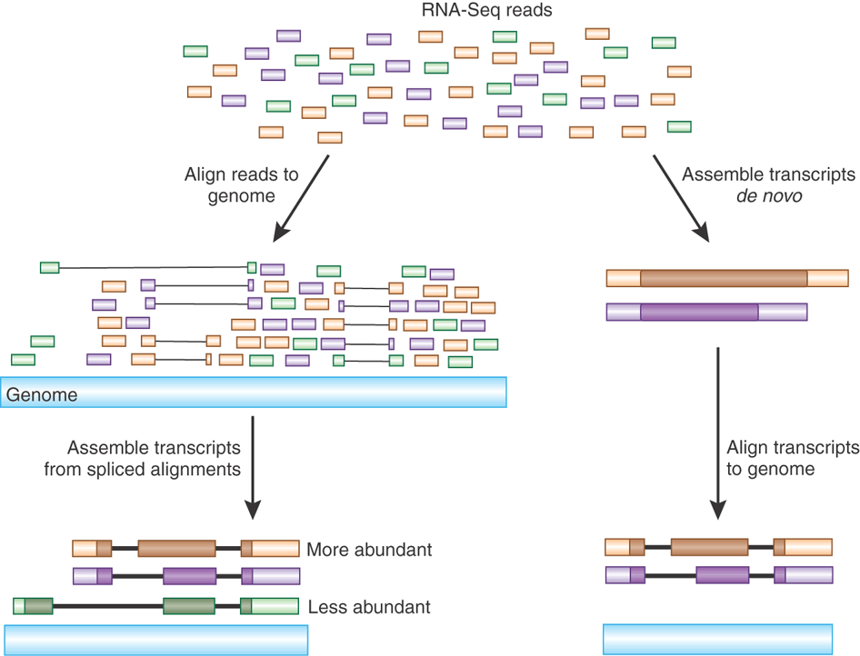
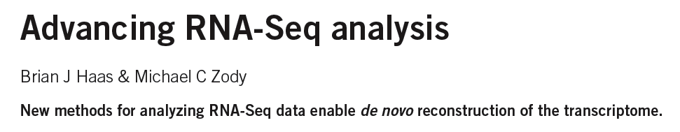
Transcript Reconstruction from RNA-Seq Reads
Nature Biotech, 2010
Notes:
One of the primary goals in RNA-Seq studies is to reconstruct the transcripts from which the short reads were derived, and transcript reconstruction is often a prerequisite to downstream studies such as genome annotation or diifferential expression analysis.
Two general strategies have been explored for reconstructing transcripts from RNA-Seq reads.

Slide 18
Transcript Reconstruction from RNA-Seq Reads
TopHat
Notes:
One strategy requires having a reference genome and involves first aligning reads to the genome using a spliced aligner.

Slide 19
Transcript Reconstruction from RNA-Seq Reads
TopHat
Cufflinks
Notes:
Then, the alignments, instead of the original reads, are assembled into transcript structures.

Slide 20

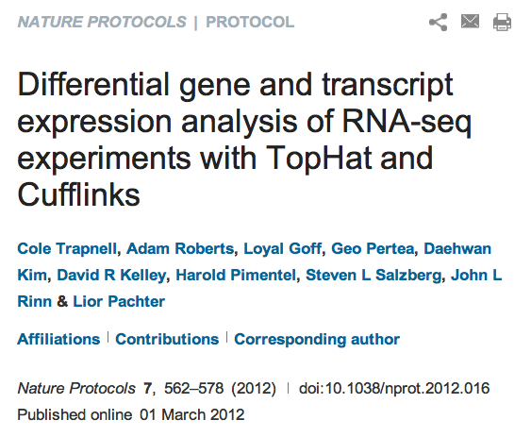

Transcript Reconstruction from RNA-Seq Reads
Trinity
TopHat
The Tuxedo Suite:
End-to-end Genome-based RNA-Seq Analysis Software Package
Cufflinks
GMAP
Notes:
Then, if a genome sequence is available, the assembled transcripts can be aligned to the genome to reveal individual introns and exons.

Slide 21
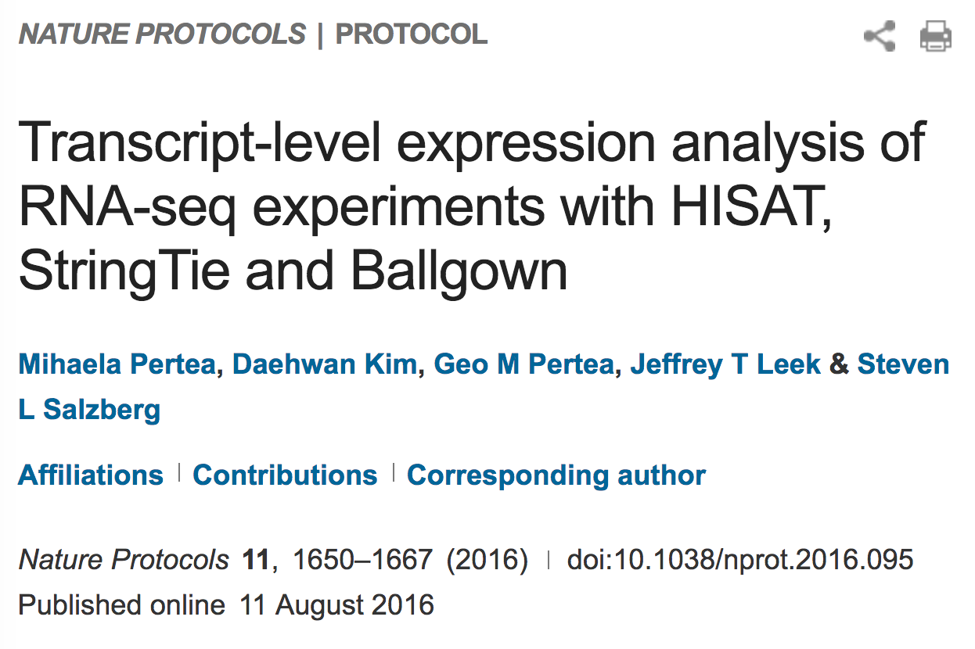
Transcript Reconstruction from RNA-Seq Reads
Trinity
HISAT
The “New Tuxedo” Suite:
End-to-end Genome-based RNA-Seq Analysis Software Package
String Tie
GMAP
Notes:
Then, if a genome sequence is available, the assembled transcripts can be aligned to the genome to reveal individual introns and exons.

Slide 22
Transcript Reconstruction from RNA-Seq Reads
Trinity
HISAT
The “New Tuxedo” Suite:
End-to-end Genome-based RNA-Seq Analysis Software Package
Non-model organisms:
“I don’t have a reference genome!”
String Tie
GMAP
Notes:
Then, if a genome sequence is available, the assembled transcripts can be aligned to the genome to reveal individual introns and exons.

Slide 23
Transcript Reconstruction from RNA-Seq Reads
TopHat
Trinity
Cufflinks
Notes:
An alternative strategy doesn’t require a reference genome and involves assembling the read sequences directly.

Slide 24
Transcript Reconstruction from RNA-Seq Reads
TopHat
Trinity
Cufflinks
GMAP
Notes:
Then, if a genome sequence is available, the assembled transcripts can be aligned to the genome to reveal individual introns and exons.

Slide 25

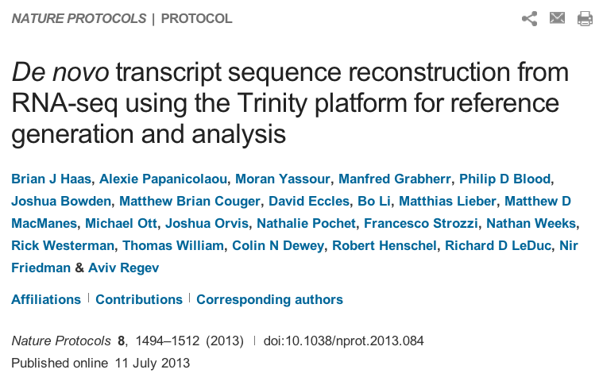
Transcript Reconstruction from RNA-Seq Reads
End-to-end Transcriptome-based RNA-Seq Analysis Software Package
Trinity
GMAP
Notes:
Trinity is a software tool that I helped develop, and which we published last year in Nature Biotechnology.
In this talk, I’ll describe how Trinity works, and describe some of the applications that we aim to support.

Slide 26
Transcript Reconstruction from RNA-Seq Reads
Many tools to choose among:
Trinity
Oases
SoapDenovoTrans
AbyssTrans
IDBA-Tran
Shannon
BinPacker
Bridger
…
TopHat STAR HISAT
GSNAP
…
GMAP
BLAT
AAT
Spidey
Sim4
…
Cufflinks
Stringtie
IsoLasso
Bayesembler
Trip
Traph
CEM
TransComb
…
Notes:
Since the advent of RNA-Seq about a decade ago, there has been great progress in the development of bioinformatics tools for performing all of these operations, supporting both genome-guided and genome-free transcriptome reconstruction and analysis.
In the next series of slides, I’ll describe the basic computational algorithms used for transcript reconstruction.

Slide 27
Graph Data Structures Commonly Used For Assembly
Sequence
Order
Orientation (+, -)
Overlap
Reads to Graph
GTC
AGTCA
GATC
CG
GATTACA
CGATCA
AGC
Nodes = sequence (+/-)
Edges = order, overlap
Notes:
Both the genome-guided and genome-free transcript reconstruction approaches share some common algorithmic techniques.
----
A general features of these algorithms is to encode read sequences, read order, orientation, and overlap information
---
into a directed graph structure, with oriented sequences represented by nodes, and directed edges indicating overlap and orientation.

Slide 28
Graph Data Structures Commonly Used For Assembly
Sequence
Order
Orientation (+, -)
Overlap
Reads to Graph
GTC
AGTCA
GATC
CG
GATTACA
CGATCA
AGC
GATCGTCCGAGCGATTACA
Nodes = sequence (+/-)
Edges = order, overlap
Notes:
Full length transcripts are then reconstructed by traversing a directed path in the graph, guided by characteristics of the original reads including mate-pair constraints.
If there are multiple well-supported paths through this graph, then this would be considered evidence for alternative splicing.

Slide 29
The General Approach to De novo RNA-Seq Assembly Using De Bruijn Graphs
Notes:
In these next sections, I’ll provide an overview of the Trinity assembly algorithm.
It’s not necessary to understand all the details of the Trinity algorithm in order to effectively use the software. If you want to, you can think of it as a black box with read sequences as input and assembled transcript contigs as output, but it is useful to understand what is happening at the various stages of the assembly when monitoring its execution or trying to troubleshoot various aspects of its behavior.

Slide 30
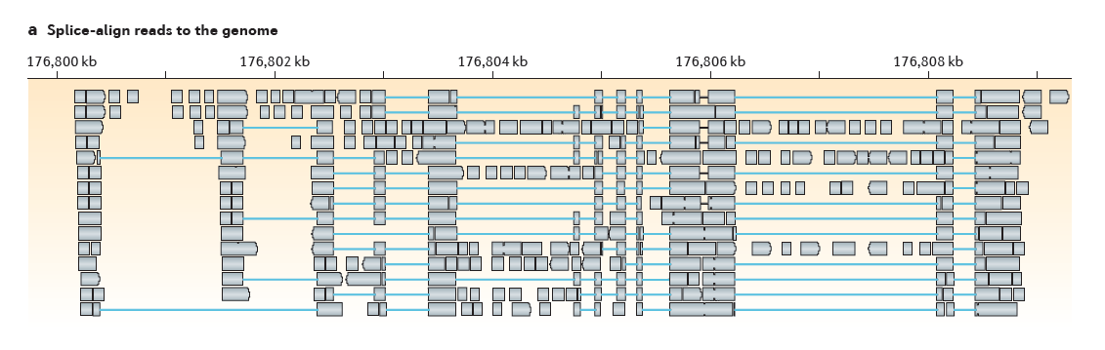
Genome-Guided Transcript Reconstruction
Splice-align reads to the genome
From Martin & Wang. Nature Reviews in Genetics. 2011
Notes:
In the case of genome-guided transcript reconstruction, the reads are aligned to the genome instead of being aligning to each other, and so we don’t encounter this scalability problem.
Here, the genome provides a scaffold by which the reads are ordered, oriented, and their overlaps are readily defined according to genomic location.
Here’s an example of a region of the genome where RNA-Seq reads were aligned…

Slide 31
Genome-Guided Transcript Reconstruction
Splice-align reads to the genome
Alignment segment piles => exon regions
From Martin & Wang. Nature Reviews in Genetics. 2011
Notes:
and we see stacks of reads piling up at locations throughout this locus.
The piles of alignment segments provide evidence of exons

Slide 32
Genome-Guided Transcript Reconstruction
Splice-align reads to the genome
Large alignment gaps => introns
From Martin & Wang. Nature Reviews in Genetics. 2011
Notes:
And the large gaps between alignment segments provide evidence of introns that were spliced out in the mature transcript.

Slide 33
Genome-Guided Transcript Reconstruction
Splice-align reads to the genome
Overlapping but different introns = evidence of alternative splicing
From Martin & Wang. Nature Reviews in Genetics. 2011
Notes:
In some cases, candidate introns are found to overlap but have different end points, and this provides evidence of alternative splicing.

Slide 34
Genome-Guided Transcript Reconstruction
Splice-align reads to the genome
From Martin & Wang. Nature Reviews in Genetics. 2011
Notes:
As discussed earlier, in order to assemble transcripts we’re going to encode the RNA-Seq data into a directed graph.
Based on the RNA-Seq read alignments, we were able to identify the individual exon and intron components of the gene expressed at this locus.

Slide 35
Genome-Guided Transcript Reconstruction
Splice-align reads to the genome
Individual reads can yield multiple exon and intron segments (splice patterns)
From Martin & Wang. Nature Reviews in Genetics. 2011
Notes:
If we look carefully, we can find examples of individual reads aligning to the genome and providing evidence for multiple introns and exons, and so we know that those introns and exons should be connected in the final transcript reconstructions.

Slide 36

Genome-Guided Transcript Reconstruction
Splice-align reads to the genome
Nodes = unique splice patterns
From Martin & Wang. Nature Reviews in Genetics. 2011
Notes:
We can identify all such unique splice patterns provided by the reads, and start building our graph using the splice patterns as nodes.

Slide 37
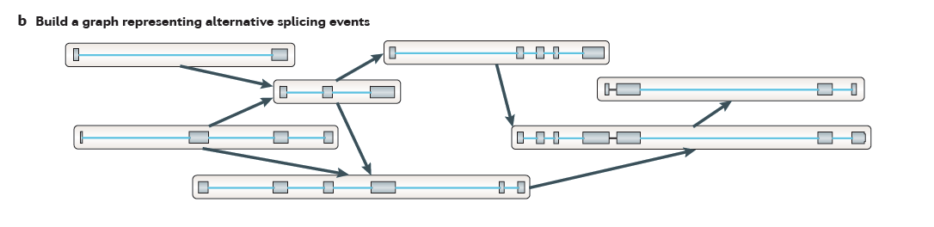
Genome-Guided Transcript Reconstruction
Splice-align reads to the genome
Construct graph from unique splice patterns of aligned reads.
Nodes = unique splice patterns
From Martin & Wang. Nature Reviews in Genetics. 2011
Notes:
We do this for all unique splice patterns. Here, the number of splice patterns is just a small fraction of the total number of aligned reads, and so we have a relatively few number of nodes to work with in our graph.

Slide 38
Genome-Guided Transcript Reconstruction
Splice-align reads to the genome
Construct graph from unique splice patterns of aligned reads.
Nodes = unique splice patterns
Edges = compatible patterns
From Martin & Wang. Nature Reviews in Genetics. 2011
Notes:
We then incorporate edges into the graph, drawing an edge between splice patterns that overlap and are compatible, that is to say that they could have come from the same transcript isoform. These are all cases where the splice patterns overlap and if there are introns in the overlapping region, those introns have identical splice sites.
For example, these top two alignment patterns overlap and they don’t conflict in their region of overlap. They could have come from the same transcript isoform, and so we can draw an edge between them.
----
Similarly, this splicing pattern demonstrates overlap, and the overlapping introns have identical splice sites, so these are deemed compatible, possibly deriving from the same transcript isoform, and we draw an edge between them.
----
We do this for all overlapping splice patterns.

Slide 39
Genome-Guided Transcript Reconstruction
Splice-align reads to the genome
Construct graph from unique splice patterns of aligned reads.
Nodes = unique splice patterns
Edges = compatible patterns
From Martin & Wang. Nature Reviews in Genetics. 2011
Notes:
Here we have those splice patterns that overlap but have different introns, and these could not have come from the same transcript, so we cannot draw an edge between them in our graph.

Slide 40
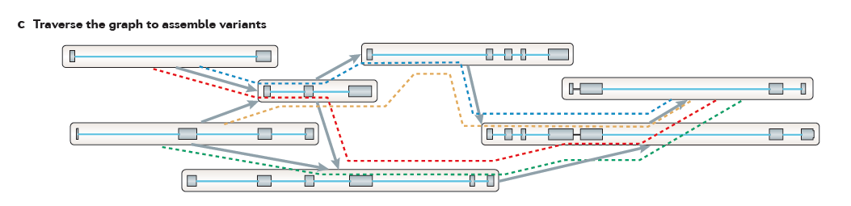
Genome-Guided Transcript Reconstruction
Traverse paths through the graph to assemble transcript isoforms
From Martin & Wang. Nature Reviews in Genetics. 2011
Notes:
Once we’ve completed our graph, we can then traverse paths through the graph to reconstruct candidate isoforms.
Here, we’ve outlined 4 possible paths…

Slide 41
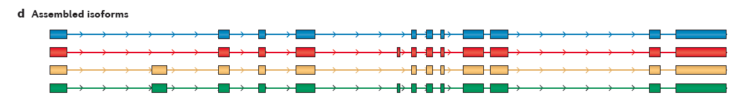
Genome-Guided Transcript Reconstruction
Traverse paths through the graph to assemble transcript isoforms
Reconstructed isoforms
From Martin & Wang. Nature Reviews in Genetics. 2011
Notes:
And tracing each path yields a different transcript structure.
There are a large number of variations of this technique, and it usually involves scoring the possible paths according to some objective function, and only reporting those candidate isoform reconstructions that are best supported by the read alignments.

Slide 42
What if you don’t have a high quality reference genome sequence?

Slide 43
Read Overlap Graph: Reads as nodes, overlaps as edges
Notes:
One way to build such a graph is treat each read as a separate node, and to perform all combinations of pairwise alignments between reads in order to identify overlaps and extensions.

Slide 44
Read Overlap Graph: Reads as nodes, overlaps as edges
Node = read
Edge = overlap
Notes:
From the overlap information, we would build an overlap graph with reads as nodes and overlaps as edges.

Slide 45
Read Overlap Graph: Reads as nodes, overlaps as edges
Transcript A
Generate consensus sequence where reads overlap
Node = read
Edge = overlap
Transcript B
Notes:
One could then trace the path of overlap extensions to assemble the longer sequence
----
If there are minor sequence differences in the regions of overlap that are likely due to sequencing error, these could be corrected by just taking a consensus and taking any original read quality information into account.

Slide 46
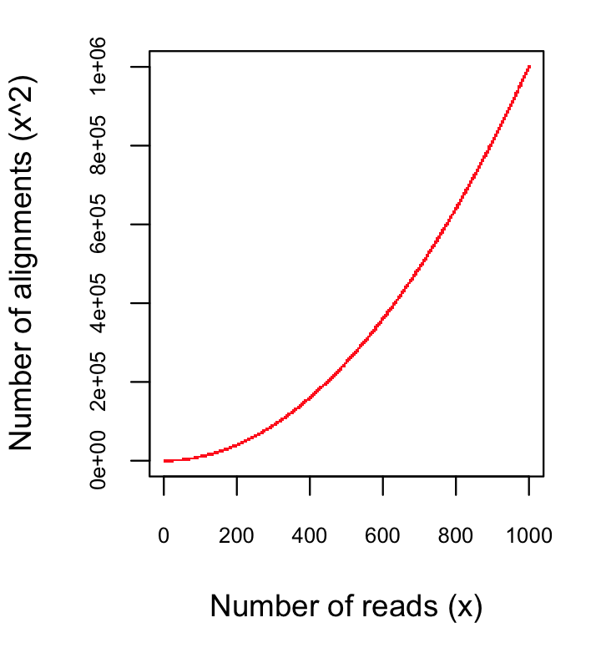
Finding pairwise overlaps between n reads involves ~ n² comparisons.
Impractical for typical RNA-Seq data (50M reads)
Notes:
This approach can be highly effective, but it simply doesn’t scale well for large data sets such as those generated using RNA-Seq.
Building the overlap graph involved aligning and comparing each read to every other read. If we have ‘n’ reads, then this would involve roughly n^2 number of comparisons.
----
If we plot the number of pairwise alignments required as a function of the number of reads, we see that the number of alignments grows exponentially.
----
This is a problem because it means that the amount of time it would take to do the alignments as well as the amount of computer hardware required to store the information would also grow exponentially, and so it’s just not a viable approach for assembling the many millions or billions of reads generated in an RNA-Seq experiment.

Slide 47
No genome to align to… De novo assembly required
Want to avoid n² read alignments to define overlaps
Use a de Bruijn graph
Notes:
If we don’t have a genome to align to, we need to be able to assemble the reads directly, but we need a way to avoid doing all pairwise alignments between the reads.
----
A popular technique for doing de novo assembly of short reads is to leverage a de Bruijn graph data structure. The de Bruijn graph was initially applied to genome assembly and was later adopted for transcriptome assembly. There are some key differences between assembling genomes and assembling transcriptomes using de Bruijn graphs, and I’ll comment more on that shortly.

Slide 48
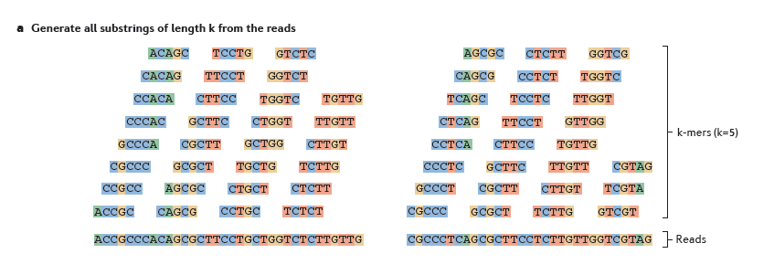
Sequence Assembly via de Bruijn Graphs
Generate all substrings of length k from the reads
k-mers (k=5)
Reads
From Martin & Wang, Nat. Rev. Genet. 2011
Notes:
A de Bruijn graph represents connectivity between sequences observed within reads, and the overlaps between reads are apparent by the virtue of having shared substrings.
The first step in a de Bruijn graph-based assembly is to construct the de Bruijn graph from the sequence reads.
Each read is decomposed into substrings of some specified length k. Each word of length k is called a k-mer. In this example, k is set to 5, so here each 5-mer is extracted from the read.
----
An ordered list of k-mers is generated by scanning a window of length k across the length of the read.

Slide 49
Sequence Assembly via De Bruijn Graphs
Generate all substrings of length k from the reads
k-mers (k=5)
Reads
From Martin & Wang, Nat. Rev. Genet. 2011
Notes:
That kmer is extracted from the read sequence

Slide 50
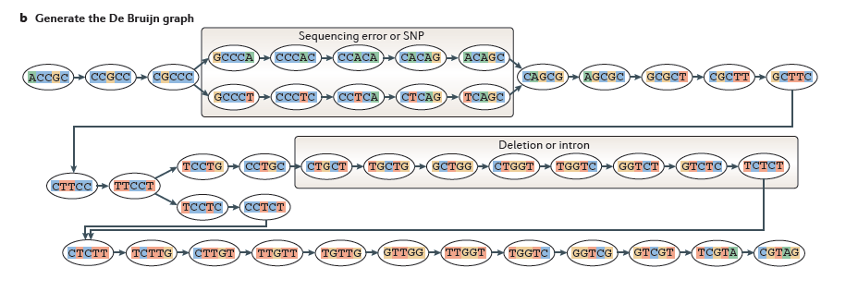
Sequence Assembly via De Bruijn Graphs
Generate all substrings of length k from the reads
k-mers (k=5)
Reads
Construct the de Bruijn graph
Nodes = unique k-mers
From Martin & Wang, Nat. Rev. Genet. 2011
Notes:
and inserted as a node in our de Bruijn graph. This graph node now represents this unique kmer sequence, and this single node will represent this unique kmer for every occurrence of this kmer in the entire set of reads.

Slide 51
Sequence Assembly via De Bruijn Graphs
Generate all substrings of length k from the reads
k-mers (k=5)
Reads
Construct the de Bruijn graph
Nodes = unique k-mers
Edges = overlap by (k-1)
From Martin & Wang, Nat. Rev. Genet. 2011
Notes:
We then shift the window over by one base, extract that k-mer…

Slide 52
Sequence Assembly via De Bruijn Graphs
Generate all substrings of length k from the reads
k-mers (k=5)
(k-1) overlap
Reads
Construct the de Bruijn graph
Nodes = unique k-mers
Edges = overlap by (k-1)
From Martin & Wang, Nat. Rev. Genet. 2011
Notes:
and insert it as another node in our de Bruijn graph.

Slide 53
Sequence Assembly via De Bruijn Graphs
Generate all substrings of length k from the reads
k-mers (k=5)
(k-1) overlap
Reads
Construct the de Bruijn graph
Nodes = unique k-mers
Edges = overlap by (k-1)
From Martin & Wang, Nat. Rev. Genet. 2011
Notes:
For each pair of neighboring k-mers, which overlap by k-1 bases, we include an edge between them in the graph.

Slide 54
Sequence Assembly via De Bruijn Graphs
Generate all substrings of length k from the reads
k-mers (k=5)
Reads
Construct the de Bruijn graph
Nodes = unique k-mers
Edges = overlap by (k-1)
From Martin & Wang, Nat. Rev. Genet. 2011
Notes:
We continue to do this for all reads and fully construct our de Bruijn graph.
This de Bruijn graph is a very effective and compact way of representing the sequence data within the reads. For example, hundreds of millions of reads can be sequenced, and the identical sequence regions within reads become compressed into individual nodes within the graph.
At positions where related sequences diverge due to allelic polymorphisms, splicing variations, repeats, or due to sequencing errors, the graph will branch and can form bulges or loops.

Slide 55
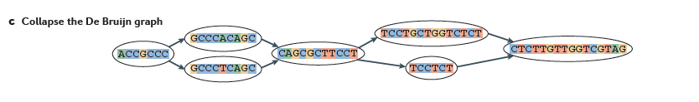
Construct the de Bruijn graph
Collapse the de Bruijn graph
From Martin & Wang, Nat. Rev. Genet. 2011
Notes:
After building the graph from all the reads, the graph is typically pruned to remove bubbles and structures that likely stem from sequencing errors,
and the graph is further simplified by collapsing those nodes that form linear unbranched chains of overlapping k-mers.
--
For example, this linear chain of kmers is compressed into a single node in the compacted graph.

Slide 56
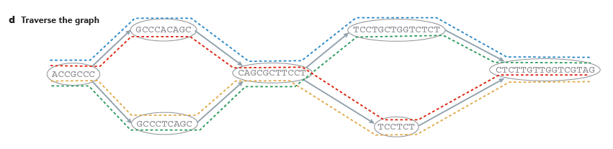
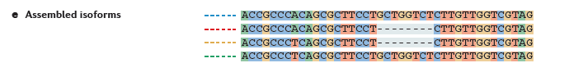
Collapse the de Bruijn graph
Traverse the graph
Assemble Transcript Isoforms
From Martin & Wang, Nat. Rev. Genet. 2011
Notes:
Now, to reconstruct transcripts, we define paths in the graph that are supported by the reads, and traverse those paths to reconstruct complete isoform sequences.
--
In this example, there are again four possible paths from the beginning to the end of the graph, each path shown traced by a different color.
By traversing each path, a different transcript sequence is generated.
--
Again, there are many different algorithms and techniques for defining best paths within this graph, and ideally the best paths reported are those that are best supported by the RNA-Seq data, taking into account the paths supported by individual read sequences and any mate-pairing information that may be available.

Slide 57

Contrasting Genome and Transcriptome De novo Assembly
Genome Assembly
Transcriptome Assembly
Uniform coverage
Exponentially distributed coverage levels
Single contig per locus
Multiple contigs per locus (alt splicing)
Assemble small numbers of large Mb-length chromosomes
Assemble many thousands of Kb-length transcripts
Double-stranded data
Strand-specific data available
Notes:
Both genome and transcriptome assemblers make use of de Bruijn graphs for assembly, but they are tuned to assemble reads according to very different expected characteristics. This is why you wouldn’t want to leverage a genome assembler for transcriptome assembly and vice-versa, since each method is highly specialized.
Some of the key differences between what’s expected by genome and transcriptome assemblers include the following:
--
Genome assemblers expect that read coverage is going to be rather uniform and will often discard sequences that occur at high coverage as repetitive sequences. In contrast, transcriptome assembly needs to consider a wide range of coverage levels spanning several orders of magnitude since sequences with high coverage are more likely to represent highly expressed transcripts instead of repeats.
--
Genome assemblers typically aim to generate a single contig per locus. In transcriptome assembly, it’s understood that single genes can generate many alternatively spliced transcripts, and multiple contigs are reported per locus where evidence of transcript complexity exists.
--
Genome assemblers aim to produce small numbers of very long contig, ideally reconstructing entire megabase-sized chromosomes where possible. Transcriptome assemblers are generally tasked with assembling many thousands of separate transcripts, on the order of thousands of bases in length.
--
Finally, in genome assembly, reads are assumed to be derived from either strand of the double-stranded DNA molecule. Conventional RNA-Seq offers the option of generating strand-specific data, and Transcriptome assemblers need to consider strand-specific data in order to assemble sense and antisense transcripts separately.

Slide 58
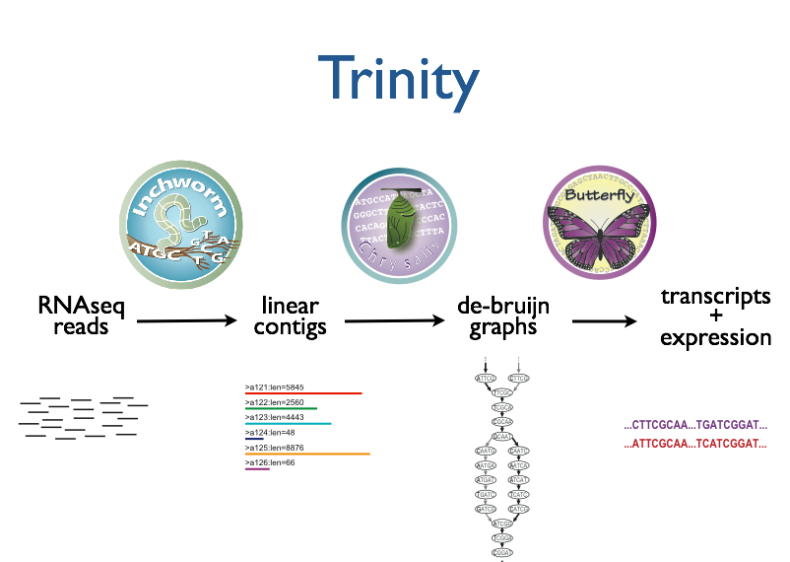



Trinity – How it works:
RNA-Seq reads
Linear
contigs
de-Bruijn
graphs
Transcripts
+
Isoforms
Thousands of disjoint graphs
Notes:
Here’s a high-level overview of the whole Trinity assembly algorithm.
We call it Trinity because it involves three major steps that we’ve built into three separate software modules.
It starts with Inchworm, which first assembles the RNA-Seq data into linear contigs.
Then, Chrysalis groups contigs that are related due to alternative splicing or gene duplication and constructs de bruijn graphs.
Finally, Butterfly examines reads in the context of the de bruijn graphs, and reports the final full-length transcripts and isoforms of transcripts.

Slide 59
Inchworm Algorithm
Decompose all reads into overlapping Kmers => hashtable(kmer, count)
Read:
AATGTGAAAACTGGATTACATGCTGGTATGTC…
AATGTGA
ATGTGAA
Overlapping kmers of length (k)
TGTGAAA
…
Kmer Catalog (hashtable)
Kmer | Count among all reads
AATGTGA | 4
ATGTGAA | 2
TGTGAAA | 1
GATTACA | 9
Notes:
The inchworm algorithm is quite simple.
It first decomposes reads into a catalog of overlapping Kmers,
----
and builds a hashtable containing the kmers and the count of the number of times that kmer is found in all the reads.

Slide 60
Inchworm Algorithm
Decompose all reads into overlapping Kmers => hashtable(kmer, count)
Identify seed kmer as most abundant Kmer, ignoring low-complexity kmers.
GATTACA
9
Kmer Catalog (hashtable)
Kmer | Count among all reads
AATGTGA | 4
ATGTGAA | 2
TGTGAAA | 1
GATTACA | 9
Notes:
The single most abundant kmer with reasonable sequence complexity is identified as a seed kmer.

Slide 61
Inchworm Algorithm
Decompose all reads into overlapping Kmers => hashtable(kmer, count)
Identify seed kmer as most abundant Kmer, ignoring low-complexity kmers.
Extend kmer at 3’ end, guided by coverage.
G
A
GATTACA
9
T
C
Notes:
This seed kmer is then extended at the 3’ end guided by the coverage of overlapping kmers.
For each extension, there are four possible kmers, each ending with one of the four possible nucleotides.

Slide 62
Inchworm Algorithm
G
4
A
GATTACA
9
T
C
Notes:
Each of the possible overlapping kmers is looked up in the kmer catalog to determine their frequency within the reads.
In this toy example, the kmer ending with ‘G’ is found 4 times.

Slide 63
Inchworm Algorithm
G
4
A
GATTACA
1
9
T
C
Notes:
‘A’ is found once.

Slide 64
Inchworm Algorithm
G
4
A
GATTACA
1
9
T
0
C
Notes:
The kmer ending with ‘T’ doesn’t exist in the reads, so it has a count of zero.

Slide 65
Inchworm Algorithm
G
4
A
GATTACA
1
9
T
0
C
4
Notes:
And the kmer ending with ‘C’ is found 4 times.

Slide 66
Inchworm Algorithm
G
4
A
GATTACA
1
9
T
0
C
4
Notes:
In this case we have a tie.

Slide 67
Inchworm Algorithm
G
A
0
5
T
1
G
4
C
A
0
GATTACA
1
9
T
0
G
C
1
4
A
1
C
T
1
1
Notes:
When we encounter a tie, we explore the tied paths recursively to find that extension that provides the highest cumulative coverage.

Slide 68
Inchworm Algorithm
G
A
0
5
T
1
G
4
C
A
0
GATTACA
1
9
T
0
G
C
1
4
A
1
C
T
1
1
Notes:
In this case, the extension of two overlapping kmers ending with an ‘A’ provides the highest cumulative coverage, and so the other paths are ignored.

Slide 69
Inchworm Algorithm
A
5
G
4
GATTACA
9
Notes:
Extensions continue to occur in this way until there are no more kmers that provide for an extension.

Slide 70
Inchworm Algorithm
A
5
C
G
0
4
T
0
GATTACA
A
9
6
G
1
Notes:
Then, we extend from right to left in the same manner, following the path of greatest coverage.

Slide 71
Inchworm Algorithm
A
5
G
4
GATTACA
A
9
6
A
7
Report contig: ….AAGATTACAGA….
Remove assembled kmers from catalog, then repeat the entire process.
Notes:
Once the extension completes, the assembled contig is reported.
--transition—
The kmers found in the contig are removed from the kmer catalog, and the entire process is repeated starting from a new seed. The Inchworm assembly ends when the entire k-mer catalog has been depleted.

Slide 72
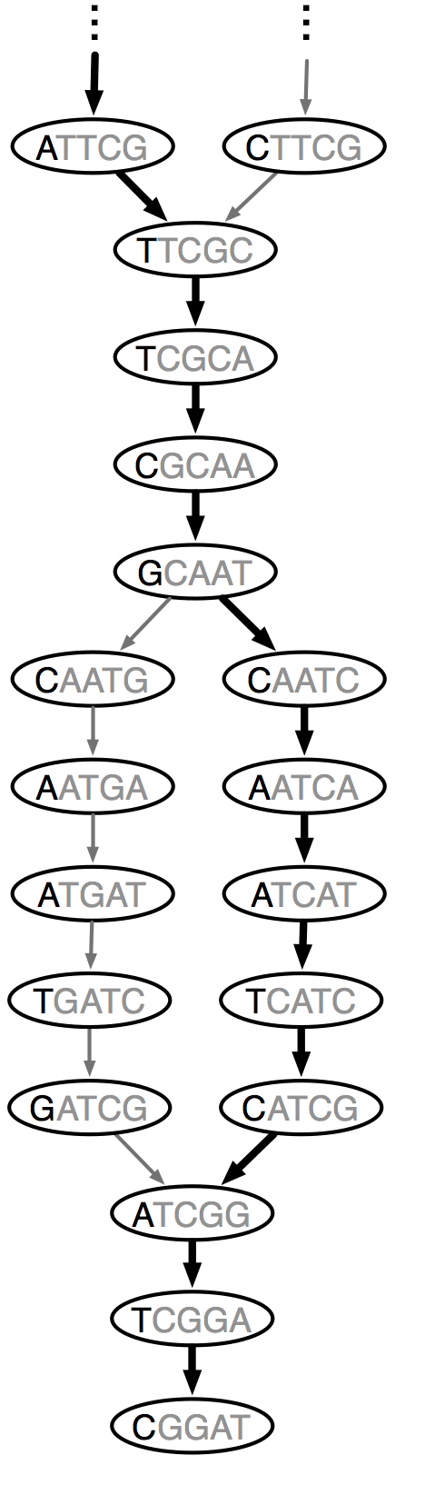
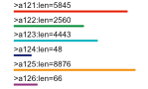
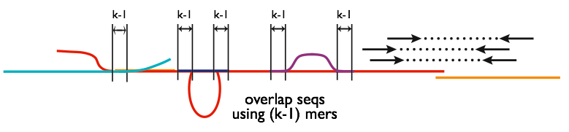
Chrysalis
Integrate isoforms
via k-1 overlaps
Build de Bruijn Graphs
(ideally, one per gene)
Notes:
Here is a high-level overview of the Chrysalis operations.
Chrysalis clusters related contigs based on these k-1mer overlaps.
Chyrsalis also leverages read pairing information to join minimally overlapping contigs.
--
After identifying the connected inchworm contigs, it constructs a separate de Bruijn graph for each group.
(Again, the de Bruijn graph represents the overlaps between adjacent kmers in the sequences with branches at sites of variation.)

Slide 73
Thousands of Chrysalis Clusters
Notes:
And this is how we end up with many separate graphs, ideally one graph per gene, with each graph representing the transcriptional complexity at that locus.
These graphs can then be processed in a parallel fashion by the next step of Trinity involving Butterfly.

Slide 74
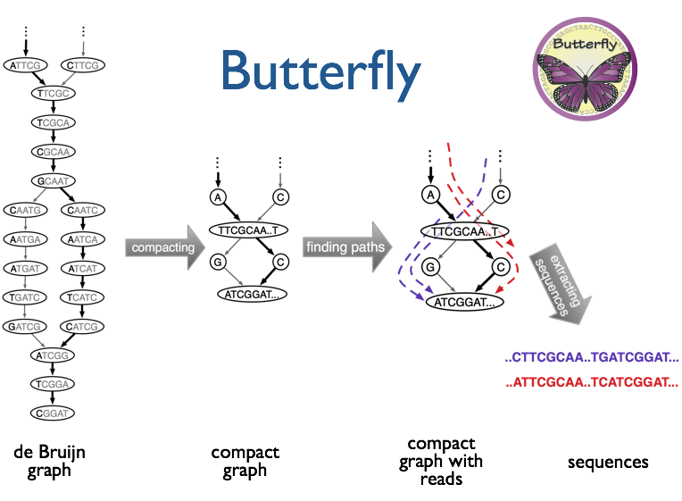
(isoforms and paralogs)
Notes:
Butterfly operates on each of these graphs independently.
It first compacts the de Bruijn graph by collapsing the unbranched stretches, as described earlier.
It then threads the original sequencing reads into the graph, tracking the paths occupied by the reads and those paths supported by mate pairs.
Butterfly then reports the most probable paths through the graph supported by the reads and read pairings, emitting full-length transcripts for isoforms and paralogs.

Slide 75
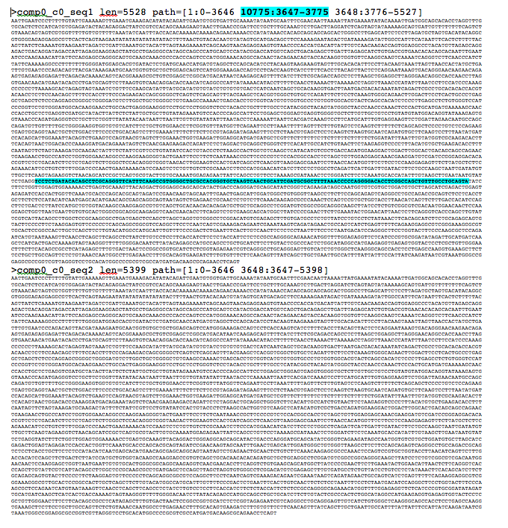
Trinity output: A multi-fasta file

Slide 76

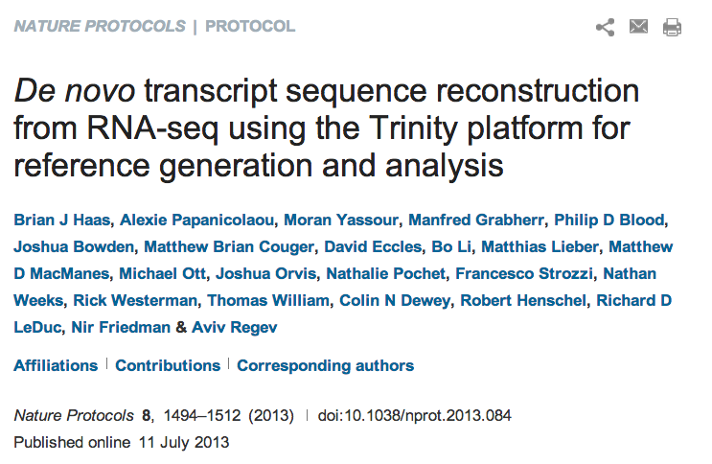
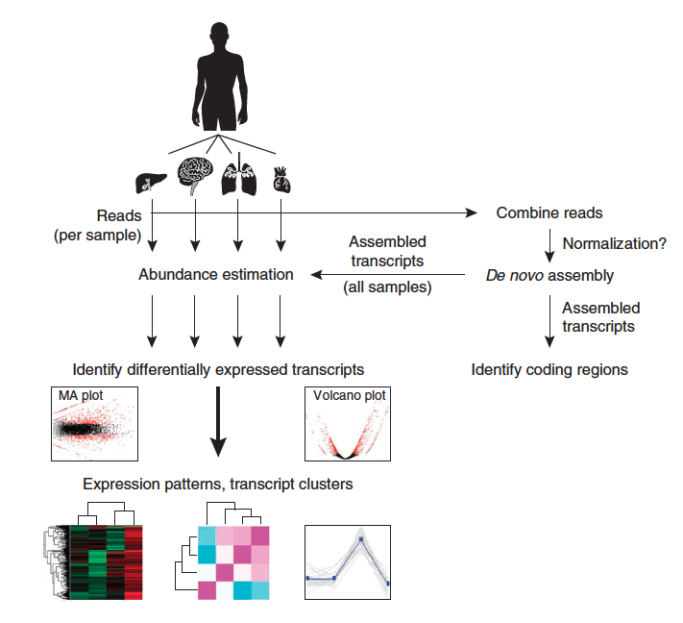
Notes:
Last year, we published a paper in Nature Protocols that outlines how you would perform a Trinity de novo assembly followed by supported downstream analyses including abundance estimation, differential expression analysis, and exploring patterns of transcript expression across multiple sample types.

Slide 77
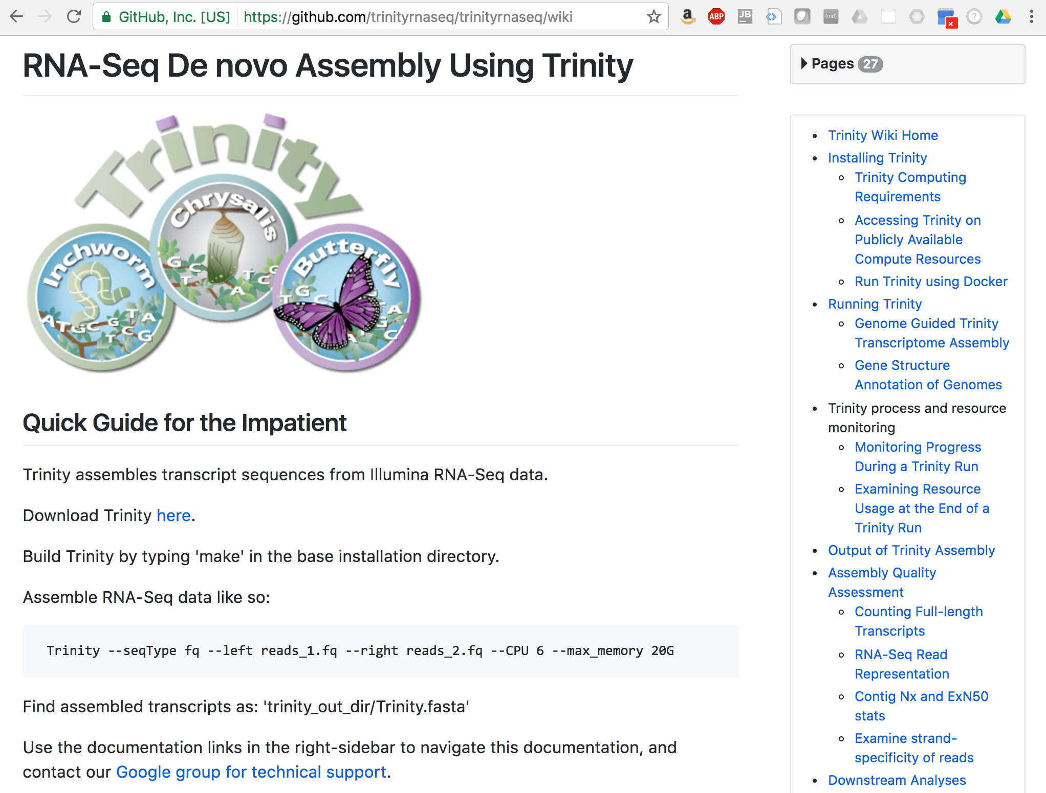

Slide 78
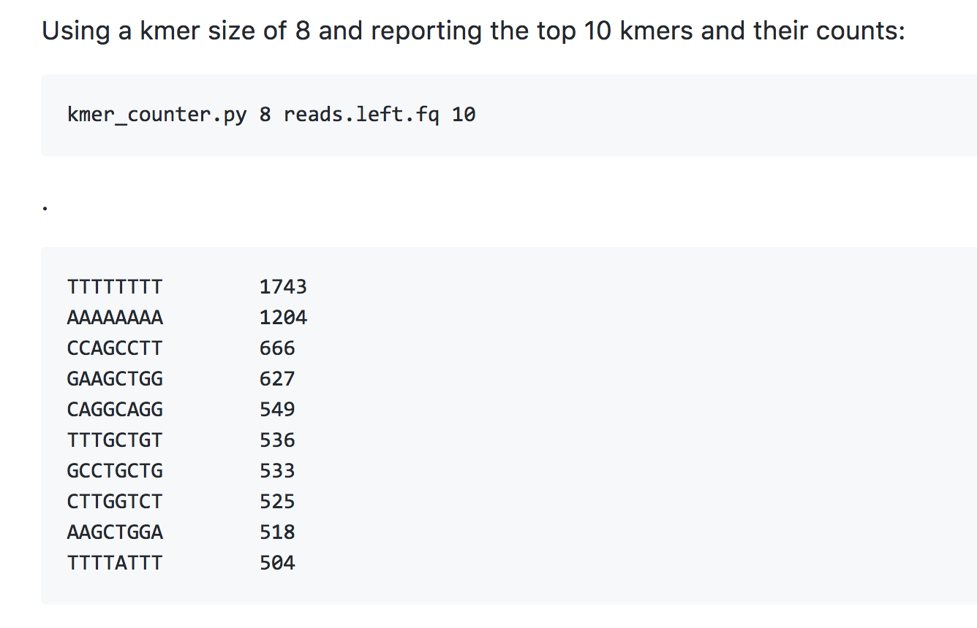
ProgForBio Exercise 1: Build a program that counts k-mers
Generate all substrings of length k from the reads
k-mers (k=5)
Reads
https://github.com/trinityrnaseq/CSHLProgForBiol2017/tree/master/Exercise_1-counting_kmers
Notes:
We continue to do this for all reads and fully construct our de Bruijn graph.
This de Bruijn graph is a very effective and compact way of representing the sequence data within the reads. For example, hundreds of millions of reads can be sequenced, and the identical sequence regions within reads become compressed into individual nodes within the graph.
At positions where related sequences diverge due to allelic polymorphisms, splicing variations, repeats, or due to sequencing errors, the graph will branch and can form bulges or loops.

Slide 79
Abundance Estimation (Aka. Computing Expression Values)

Slide 80
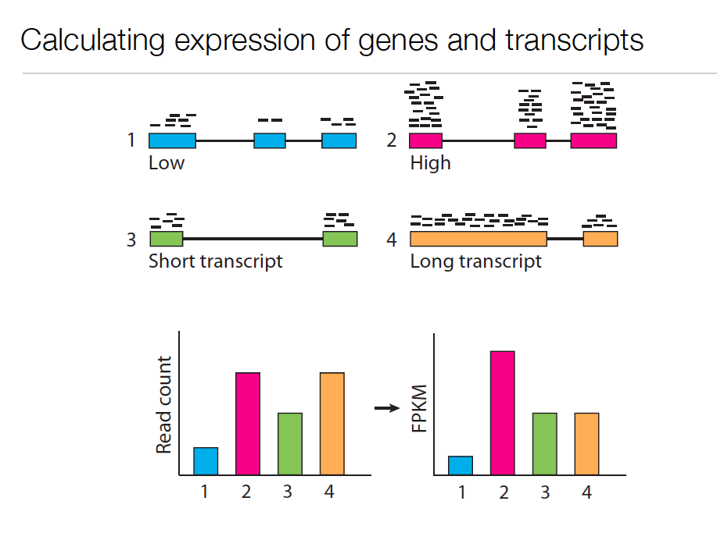
Expression Value
Slide courtesy of Cole Trapnell
Notes:
In RNA-Seq, the expression of a transcript is measured based on the number of RNA-Seq reads sampled that map to the corresponding transcript.
The number of reads sequenced for a transcript depends on a number of factors.
For one, the number of reads observed depends on the expression of the transcript. Transcripts that are expressed at higher levels should account for more reads in the sample than those expressed at lower levels if all else is equal.
Also, the sequencing depth must be taken into account. The deeper you sequence, the more reads you’ll observe mapping to transcripts at any expression level.

Slide 81
Expression Value
Slide courtesy of Cole Trapnell
Notes:
The number of reads corresponding to a transcript also depends on its length. Longer transcripts represent more real estate in the sequencing library than shorter transcripts expressed at the same level (number of transcripts per cell).

Slide 82
Normalized Expression Values
Transcript-mapped read counts are normalized for both length of the transcript and total depth of sequencing.
Reported as: Number of RNA-Seq Fragments Per Kilobase of transcript per total Million fragments mapped
FPKM
RPKM (reads per kb per M) used with Single-end RNA-Seq reads
FPKM used with Paired-end RNA-Seq reads.
Notes:
And so, when computing expression for transcripts, both the number of reads mapping to each transcript and the lengths of those transcripts must be taken into account.
The metric reported is often in units of FPKM.

Slide 83
Transcripts per Million (TPM)
Preferred metric for measuring expression
Better reflects transcript concentration in the sample.
Nicely sums to 1 million
Linear relationship between TPM and FPKM values.
TPM
Both are valid metrics, but best to be consistent.
FPKM

Slide 84
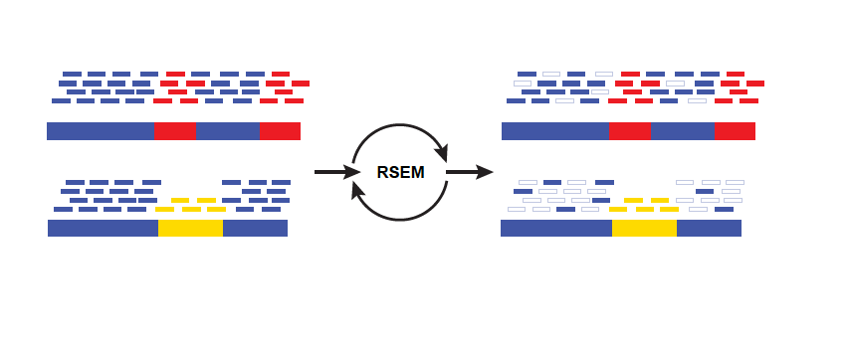
Multiply-mapped Reads Confound Abundance Estimation
Isoform A
EM
Isoform B
Blue = multiply-mapped reads
Red, Yellow = uniquely-mapped reads
Notes:
Accurately estimating transcript expression levels is actually much more complicated due to the fact that not all RNA-Seq reads are able to map uniquely to their corresponding transcript.
This is particularly the case for alternatively spliced transcripts. Such transcripts are not entirely identical, but can share a substantial amount of sequence in common, differing at sites of splicing variation, such as due to skipped exons or from differential splice site selection.
Here’s an example of the problem, where we have two isoforms A, B, with shared sequences in blue and isoform- unique sequences in yellow or red. Reads mapping to either the yellow or red sequences will map uniquely and unambiguously. However, the reads that map to the blue regions will map ambiguously. It isn’t obvious as to which transcript the reads were derived. Using sophisticated statistical inference methods, we can infer the likelihood of a blue read having been derived from one isoform or the other, by taking into account the number of uniquely mapping reads and the length of each isoform.

Slide 85
Multiply-mapped Reads Confound Abundance Estimation
Estimate expression,
Compute likelihood
Isoform A
EM
Adj Model Params,
Proportioning Reads
Isoform B
Blue = multiply-mapped reads
Use Expectation Maximization (EM) to find the most likely assignment of reads to transcripts.
Performed by:
Cufflinks, String Tie (Tuxedo)
RSEM, eXpress (genome-free)
Kallisto, Salmon (alignment-free)
Red, Yellow = uniquely-mapped reads
Notes:
There are tools available that implement these methods, which rely on the technique of expectation maximization.
Expectation maximization involves cycling between estimating parameters of a statistical model based on the data, and computing likelihood estimates of results from applying those model parameters.
In this case, you can think of the algorithm as fractionally assigning the blue reads to each isoform and estimating the likelihood of those assignments. With each iteration of the algorithm, the read assignments become more likely, and eventually the likelihood will converge to a maximum value. Finally, the counts of reads assigned to each isoform are reported.

Slide 86
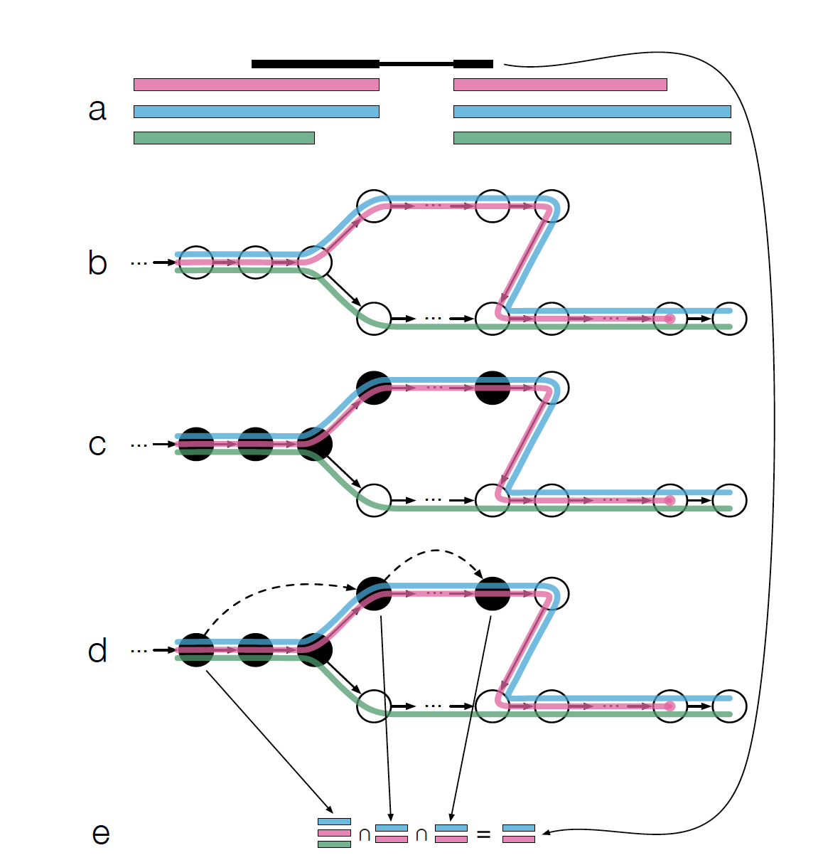
Fast Abundance Estimation Using Pseudo-alignments and Equivalence Classes (Kallisto software, Bray et al., NBT 2016)
Adapted from Fig 1 from Bray et al.

Slide 87
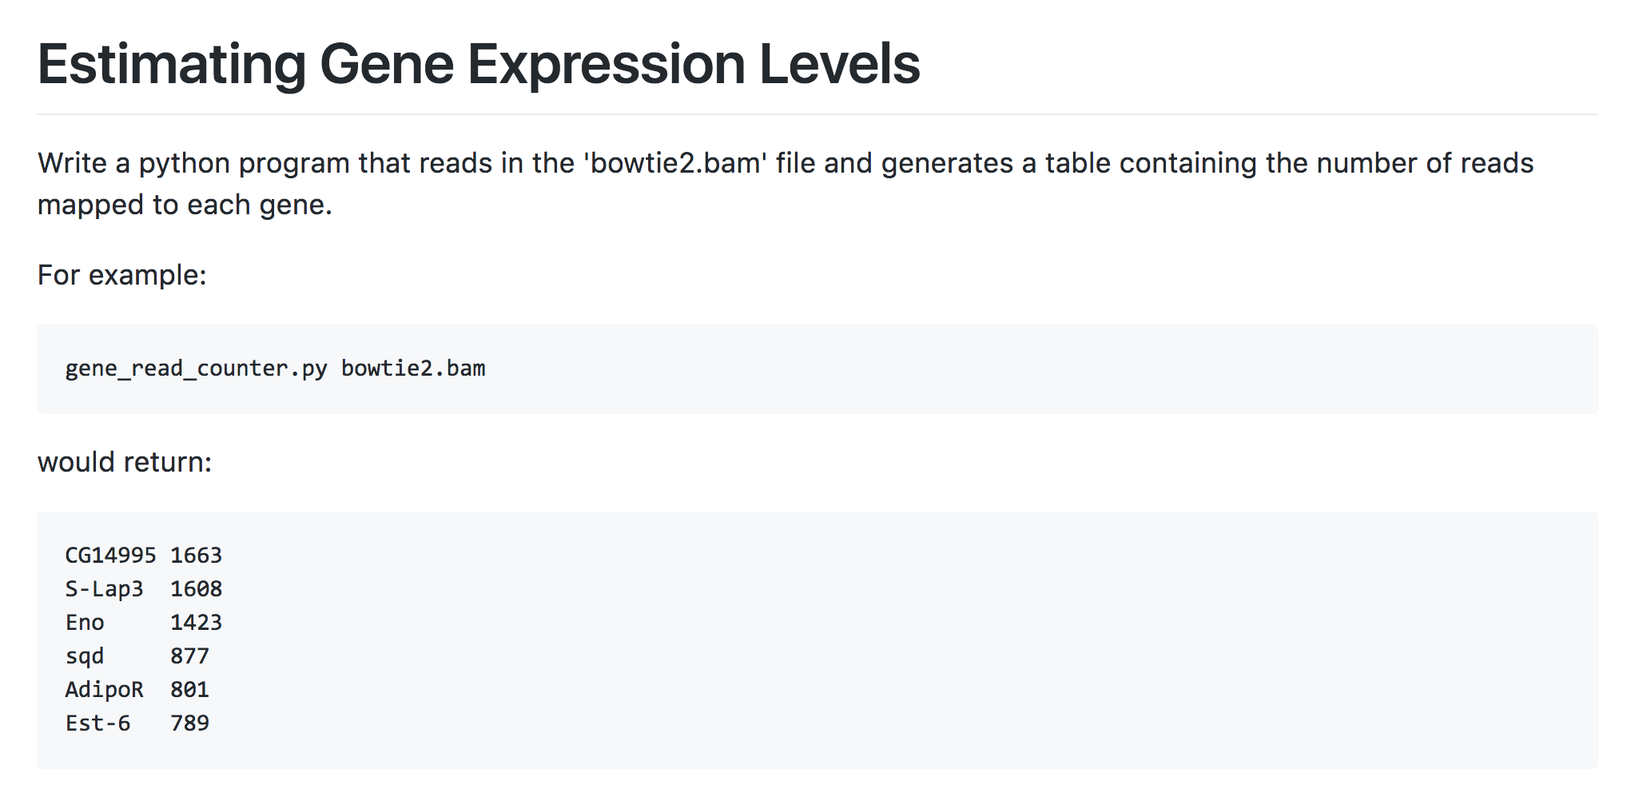
ProgForBio Exercise 2: Build a utility that measures expression by counting aligned reads
…
https://github.com/trinityrnaseq/CSHLProgForBiol2017/tree/master/Exercise_2-aligned_reads_to_expression

Slide 88

Differential Expression Analysis
Thx, Charlotte Soneson! ☺

Slide 89
Differential Expression Analysis Involves
Counting reads mapped to features
Statistical significance testing
Beware of small counts leading to notable fold changes
Sample_A
Sample_B
Fold_Change
Significant?
Gene A
1
2
2-fold
No
Gene B
100
200
2-fold
Yes

Slide 90
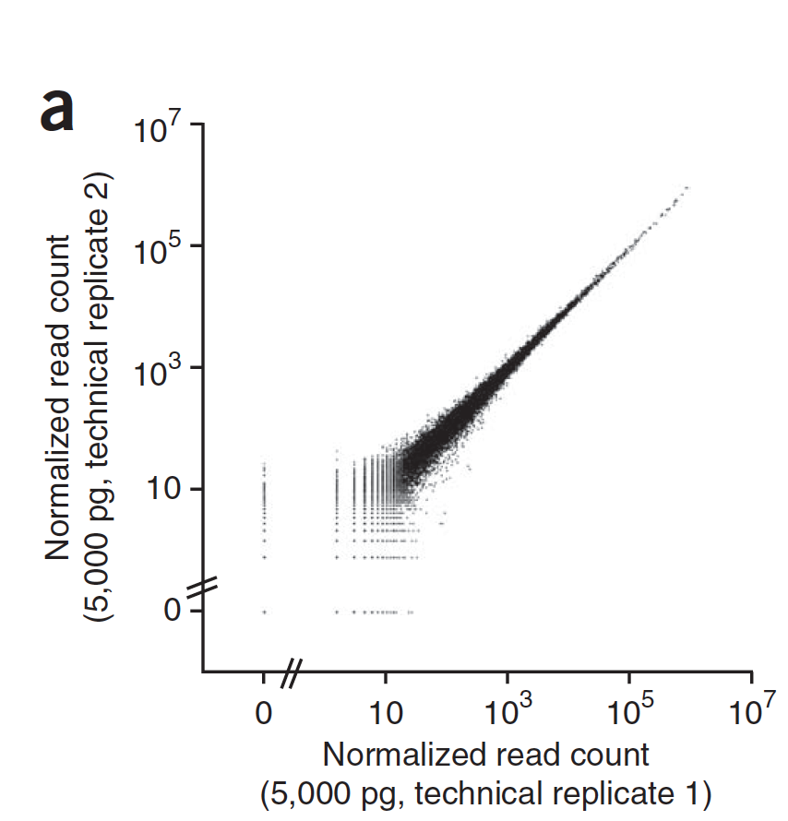
Variation Observed Between Technical Replicates
Variation observed is well described by models of random sampling
(Poisson Distribution)
Poisson shot noise is high for small counts.
* plot from Brennecke, et al. Nature Methods, 2013

Slide 91
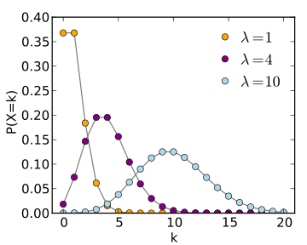
Observed RNA-Seq Counts Result from Random Sampling of the Population of Reads
Technical variation in RNA-Seq counts per feature is well modeled by the Poisson distribution
Mean # fragments
(observed read counts)
See: http://en.wikipedia.org/wiki/Poisson_distribution
Notes:
When we count reads, what we’re really doing is randomly sampling reads from a population.
Observed counts resulting from random sampling are well modeled by the Poisson distribution.
It has been shown that technical replicates of rna-seq samples, where it’s the same sample (which should show no differentially expressed transcripts), yield distributions of counts that are well modeled by Poisson.

Slide 92
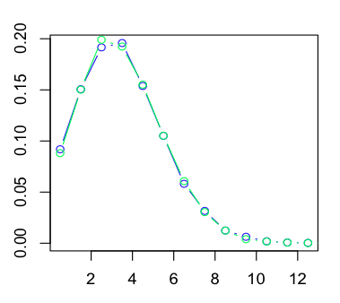
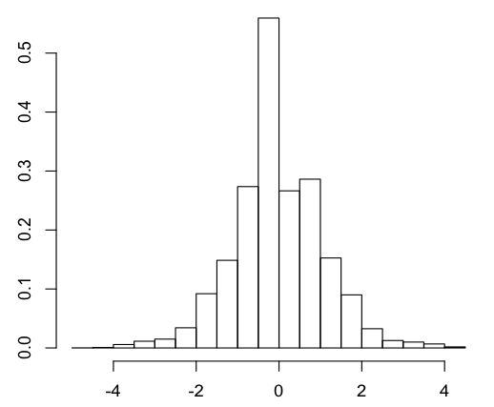
Example: One gene*not* differentially expressed
Example: SampleA(gene) = SampleB(gene) = 4 reads
Distribution of observed counts for single gene (under Poisson model)
Dist. of log₂(fold change) values
same
SampleA(geneX)
SampleB(geneX)
2-fold diff
density
density
4-fold diff
(k) number of reads observed
x = log₂(SampleA/SampleB)

Slide 93
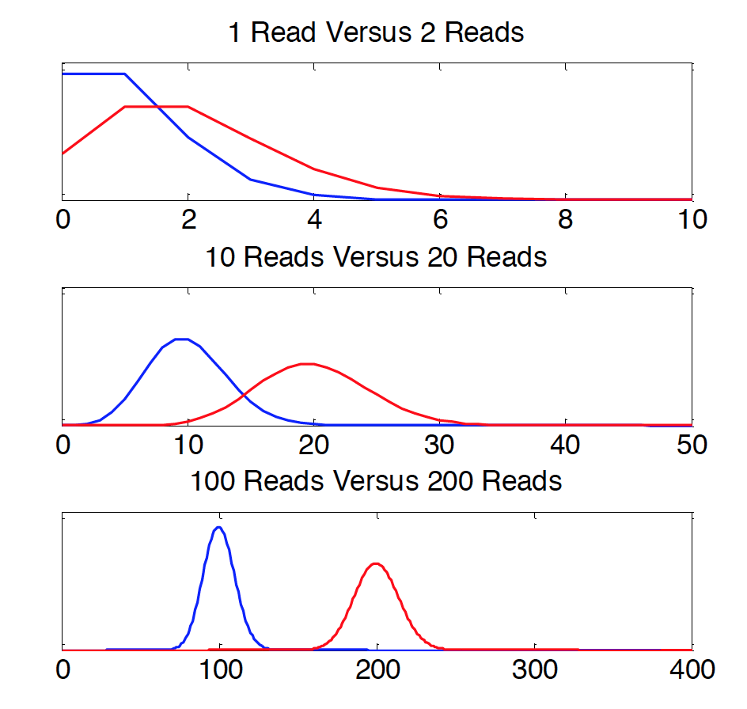
Sequencing Depth Matters
Poisson distributions for counts based on 2-fold expression differences
No confidence in 2-fold difference. Likely observed by chance.
P(x=k)
High confidence in 2-fold difference. Unlikely observed by chance.
Observed Read Count (k)
From: http://gkno2.tumblr.com/post/24629975632/thinking-about-rna-seq-experimental-design-for
and from supplementary text of Busby et al., Bioinformatics, 2013
Notes:
Can’t deduce with confidence that the transcripts are two-fold differentially expressed based on the distribution of observed counts. Sequence deeper.
Poisson noise limits the ability to confidently detect differential expression with small values of read counts.

Slide 94
Greater Depth = More Statistical Power
Example: Single gene, reads sampled at different sequencing depths
Reads per sample | Sample A Number of reads | Sample B Number of reads | P-value (Fishers Exact Test)
100,000 | 1 | 2 | 1
1,000,000 | 10 | 20 | 0.099
10,000,000 | 100 | 200 | 8.0e-09

Slide 95


Tools for DE analysis with RNA-Seq
edgeR
ShrinkSeq DESeq
baySeq
Vsf
Limma/Voom
mmdiff
cuffdiff
ROTS
TSPM
DESeq2
EBSeq
NBPSeq
SAMseq
NoiSeq
(italicized not in R/Bioconductor
but stand-alone)
See: http://www.biomedcentral.com/1471-2105/14/91
A comparison of methods for differential expression analysis of RNA-seq data
Soneson & Delorenzi, 2013

Slide 96
Typical output from DE analysis
logFC logCPM PValue FDR
TRINITY_DN876_c0_g1_i1 -7.15049572793027 10.6197708379285 0 0
TRINITY_DN6470_c0_g1_i1 -7.26777912190146 7.03987604865422 1.687485656951e-287 6.46813252309319e-284
TRINITY_DN5186_c0_g1_i1 -7.85623682454322 9.18570464327063 1.17049180235068e-278 2.99099671894011e-275
TRINITY_DN768_c0_g1_i1 7.72884741150304 9.7514619195169 4.32504881419265e-272 8.28895605240022e-269
TRINITY_DN70_c0_g1_i1 -12.7646078189688 7.86482982471445 3.92853491279431e-253 6.02322972829624e-250
TRINITY_DN1587_c0_g1_i1 -5.89392061881667 9.07366563894607 6.32919557933429e-243 8.08660221852944e-240
TRINITY_DN3236_c0_g1_i1 -7.27029815068473 8.02209568234202 3.64955175271959e-235 3.99678053376405e-232
TRINITY_DN4631_c0_g1_i1 -7.45310693639574 6.91664918183241 4.30540921272851e-229 4.1256583780971e-226
TRINITY_DN5082_c0_g5_i1 -5.33154406167545 10.6977538760467 2.74243356676259e-225 2.33594396920022e-222
TRINITY_DN1789_c0_g3_i1 10.2032564835076 7.32607652700285 1.44273728647186e-213 1.10600240380933e-210
TRINITY_DN4204_c0_g1_i1 4.81030233739325 9.88844409410644 9.27180216086162e-205 6.46160321501501e-202
TRINITY_DN799_c0_g1_i1 -4.22044475626154 6.9937398638711 1.24746518421083e-197 7.96922341846683e-195
TRINITY_DN196_c0_g2_i1 4.60597918494257 9.86878463857276 1.9819997623131e-192 1.16877001368402e-189
TRINITY_DN5041_c0_g1_i1 -4.27126549355785 9.70894399883 1.8930437900069e-185 1.03657669244235e-182
TRINITY_DN1619_c0_g1_i1 -4.47156415953777 9.22535948721718 1.76766063029526e-181 9.03392426122899e-179
TRINITY_DN899_c0_g1_i1 -4.90914328409143 7.93768691394594 1.11054513767547e-180 5.32089939088761e-178
TRINITY_DN324_c0_g2_i1 4.87160837667488 6.84850312231775 2.20092562166991e-179 9.92487989160089e-177
TRINITY_DN3241_c0_g1_i1 -4.77760618069256 7.94111259715689 1.60585457735621e-173 6.83915621667372e-171
TRINITY_DN4379_c0_g1_i1 3.85133572453294 7.23712813663389 3.48140532848425e-164 1.4046554341137e-161
TRINITY_DN1919_c0_g1_i1 4.05998814332136 6.95937301668582 1.8588621194715e-161 7.12501850393425e-159
TRINITY_DN2504_c0_g1_i1 -6.92417817059644 6.20370039359785 2.42022459856956e-160 8.83497227268296e-158
…
Up vs. Down regulated
Avg. expression level
Significance

Slide 97
ProgForBio Exercise 3: Exploring DE Statistics
logFC logCPM PValue FDR
TRINITY_DN876_c0_g1_i1 -7.15049572793027 10.6197708379285 0 0
TRINITY_DN6470_c0_g1_i1 -7.26777912190146 7.03987604865422 1.687485656951e-287 6.46813252309319e-284
TRINITY_DN5186_c0_g1_i1 -7.85623682454322 9.18570464327063 1.17049180235068e-278 2.99099671894011e-275
TRINITY_DN768_c0_g1_i1 7.72884741150304 9.7514619195169 4.32504881419265e-272 8.28895605240022e-269
TRINITY_DN70_c0_g1_i1 -12.7646078189688 7.86482982471445 3.92853491279431e-253 6.02322972829624e-250
TRINITY_DN1587_c0_g1_i1 -5.89392061881667 9.07366563894607 6.32919557933429e-243 8.08660221852944e-240
TRINITY_DN3236_c0_g1_i1 -7.27029815068473 8.02209568234202 3.64955175271959e-235 3.99678053376405e-232
TRINITY_DN4631_c0_g1_i1 -7.45310693639574 6.91664918183241 4.30540921272851e-229 4.1256583780971e-226
TRINITY_DN5082_c0_g5_i1 -5.33154406167545 10.6977538760467 2.74243356676259e-225 2.33594396920022e-222
TRINITY_DN1789_c0_g3_i1 10.2032564835076 7.32607652700285 1.44273728647186e-213 1.10600240380933e-210
TRINITY_DN4204_c0_g1_i1 4.81030233739325 9.88844409410644 9.27180216086162e-205 6.46160321501501e-202
TRINITY_DN799_c0_g1_i1 -4.22044475626154 6.9937398638711 1.24746518421083e-197 7.96922341846683e-195
TRINITY_DN196_c0_g2_i1 4.60597918494257 9.86878463857276 1.9819997623131e-192 1.16877001368402e-189
TRINITY_DN5041_c0_g1_i1 -4.27126549355785 9.70894399883 1.8930437900069e-185 1.03657669244235e-182
TRINITY_DN1619_c0_g1_i1 -4.47156415953777 9.22535948721718 1.76766063029526e-181 9.03392426122899e-179
TRINITY_DN899_c0_g1_i1 -4.90914328409143 7.93768691394594 1.11054513767547e-180 5.32089939088761e-178
TRINITY_DN324_c0_g2_i1 4.87160837667488 6.84850312231775 2.20092562166991e-179 9.92487989160089e-177
TRINITY_DN3241_c0_g1_i1 -4.77760618069256 7.94111259715689 1.60585457735621e-173 6.83915621667372e-171
TRINITY_DN4379_c0_g1_i1 3.85133572453294 7.23712813663389 3.48140532848425e-164 1.4046554341137e-161
TRINITY_DN1919_c0_g1_i1 4.05998814332136 6.95937301668582 1.8588621194715e-161 7.12501850393425e-159
TRINITY_DN2504_c0_g1_i1 -6.92417817059644 6.20370039359785 2.42022459856956e-160 8.83497227268296e-158
…
Write a program that computes the number of DE transcripts at a range of FDR and logFC thresholds.
https://github.com/trinityrnaseq/CSHLProgForBiol2017/tree/master/Exercise_3-filtering_DE_results

Slide 98
Visualization of DE results and Expression Profiling

Slide 99
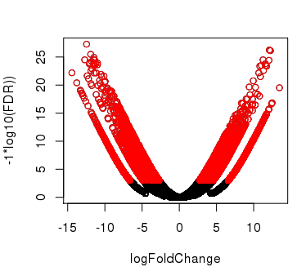

Plotting Pairwise Differential Expression Data
Volcano plot
( fold change vs. significance)
MA plot
(abundance vs. fold change)
Log₁₀ (FDR)
Log₂ (fold change) (M of MA)
Log₂ (fold change)
Log₂ Average Expression level (A of MA)
Significantly differently expressed transcripts have FDR <= 0.001
(shown in red)

Slide 100

Comparing Multiple Samples
Heatmaps provide an effective tool for navigating differential expression across multiple samples.
Clustering can be performed across both axes:
-cluster transcripts with similar expression patters.
-cluster samples according to similar expression values among transcripts.

Slide 101

Examining Patterns of Expression Across Samples
Can extract clusters of transcripts and examine them separately.

Slide 102
Summary of Key Points
RNA-Seq is a versatile method for transcriptome analysis enabling quantification and novel transcript discovery.
Expression quantification is based on sampling and counting reads derived from transcripts
Fold changes based on few read counts lack statistical significance.
Trinity assembly and supported downstream computational analysis tools facilitate transcriptome studies.

Slide 103
Visit website for more info:
http://trinityrnaseq.github.io

Slide 104
Let’s go write some code! ☺

